Slide 1
Visualization Design
JOUR479D/779D
University of Maryland

Slide 2
Brainstorming
What are all of the ways you could possibly communicate a tiny data set of just two numbers?
A: 9
B: 6
Sketch each idea on a separate sticky note.
Don’t consider “good” or “bad” during brainstorming
Afterwards we’ll discuss.
http://blog.visual.ly/45-ways-to-communicate-two-quantities/
Notes:
http://blog.visual.ly/45-ways-to-communicate-two-quantities/
There are MANY different ways to map data to visuals. Some are better than others. Just imaging how much more complexity with more than TWO numbers!

Slide 3
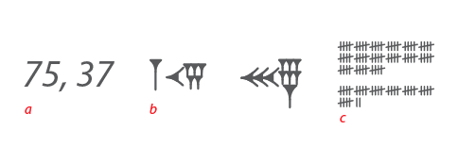
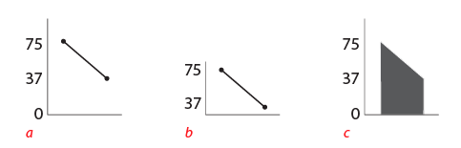
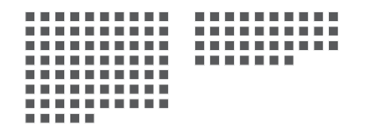
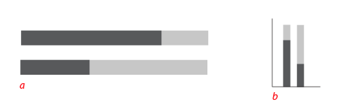
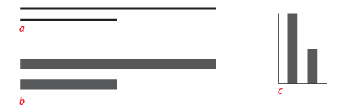
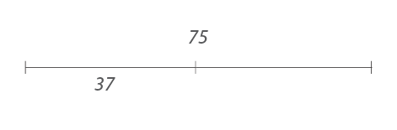
For Example

Slide 4

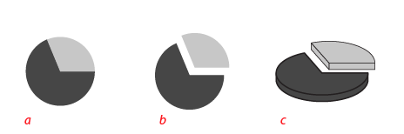

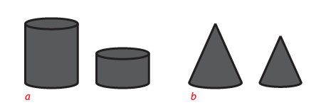
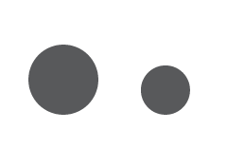

For Example

Slide 5
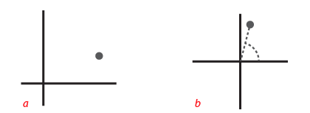
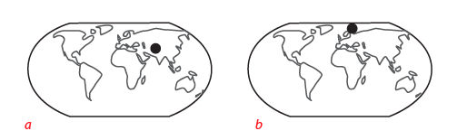

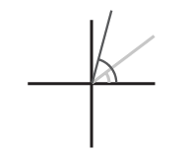
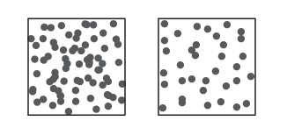
For Example
Notes:
It’s helpful to sketch ideas and explore what you can do visually with the data and data types you have available.

Slide 6
“Form Follows Function”
Visualizations are not arbitrary
Objectivity, precision, functionality constrain the forms they take
Ask: What is this for?
Discover
Present
Enjoy
Identify
Compare
Summarize
Is it good at any of these?
Notes:
Of course we can come up with many different ways to show data, but there are better and worse ways since these representations need to do work.
The form of your visualization should be constrained by its functions. This is the key idea about functional design.
But there is also the idea of repurposing – that forms can be repurposed for new / different functions that weren’t anticipated.

Slide 7
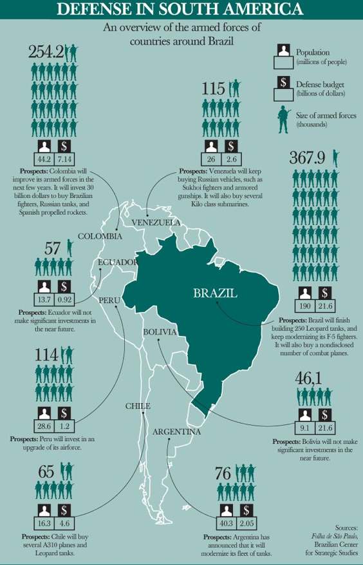
Notes:
What does the designer want me to do with this graphic?
So, in terms of present, compare, organize, and relate – what does this graphic do well?

Slide 8
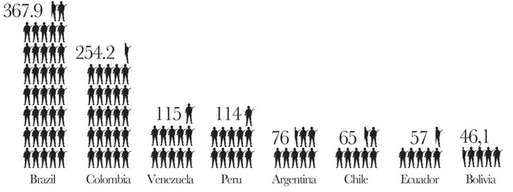
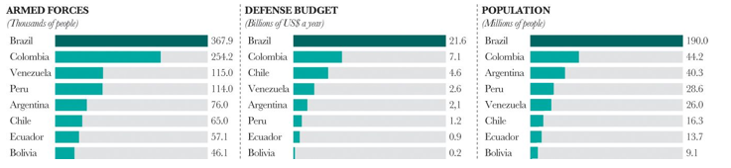
Facilitating Comparison
Notes:
By reorganizing icons on a common baseline we make comparison easier. By using standard bar charts we make it even easier.

Slide 9
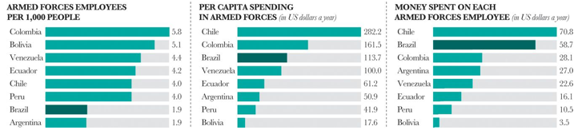
Normalizing
Notes:
Normalizing by population changes the story even further.

Slide 10
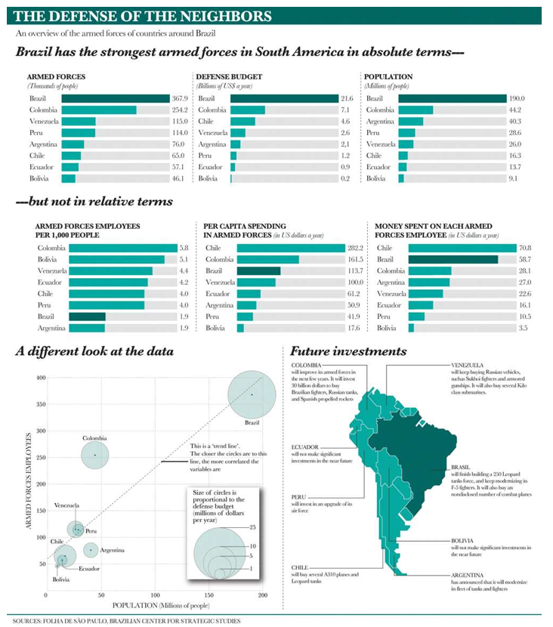
Notes:
Many different ways to say the same thing (bar charts, scatter charts). Scatter shows relationship and who’s above / below avg. As we learned from the exercise there are many different ways of encoding data.

Slide 11
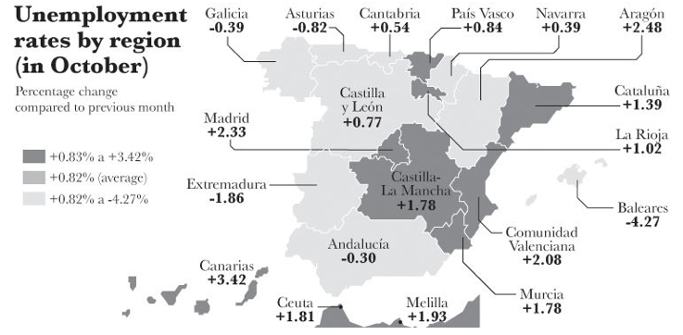
Critique
Where has unemployment grown the most?

Slide 12
Critique
Where has it dropped the most?

Slide 13
Critique
Was unemployment change bigger in Madrid or Canarias?

Slide 14
Critique
Has unemployment dropped more in Extremadura, Andalucia, or Baleares?

Slide 15
Task Design
If we anticipate questions that readers will ask, we can design visualizations so that those questions are easier to answer.
How does the design assist cognition and analytic thinking about the data?
What is this graphic for?

Slide 16
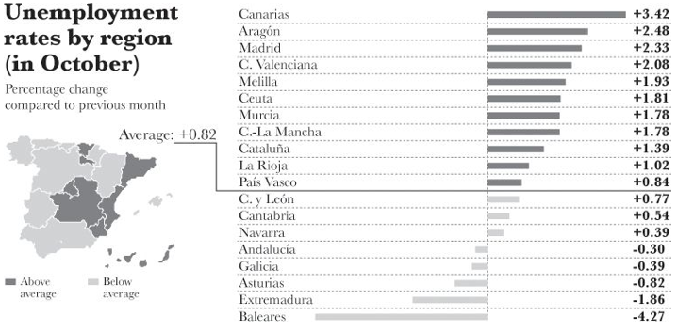
Task Design

Slide 17
Chart Design Guidelines
When to use what chart for what purpose?
Few hard and fast rules, but there are tried and true guidelines
There are a LOT of different types of chart
People also invent new representations, but it’s not always clear if they are better or worse.

Slide 18
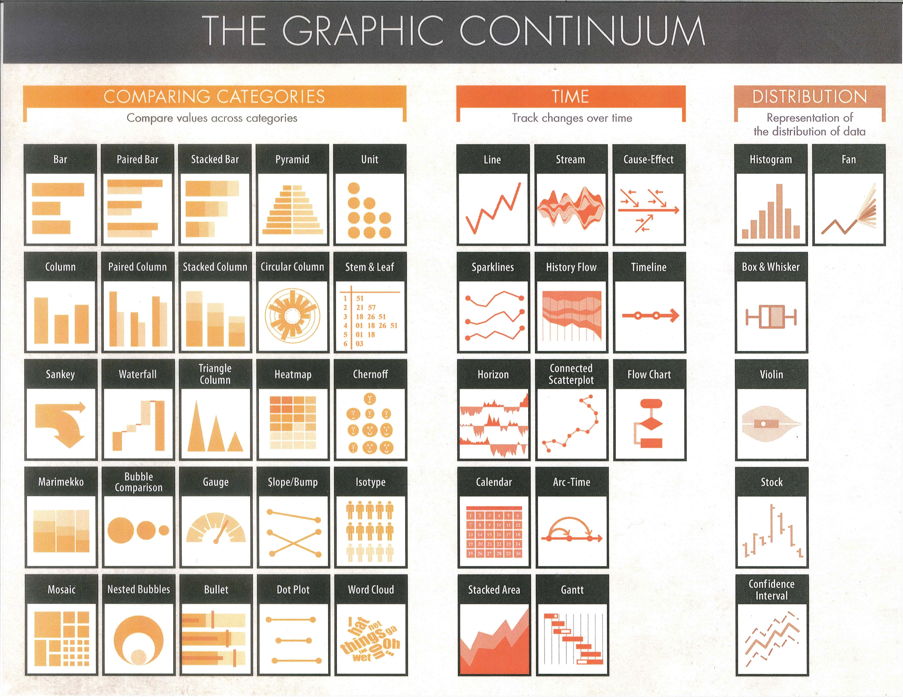
Notes:
Major decision in visualization design relates to choosing the right visual form for the data and the task that you want to support.

Slide 19
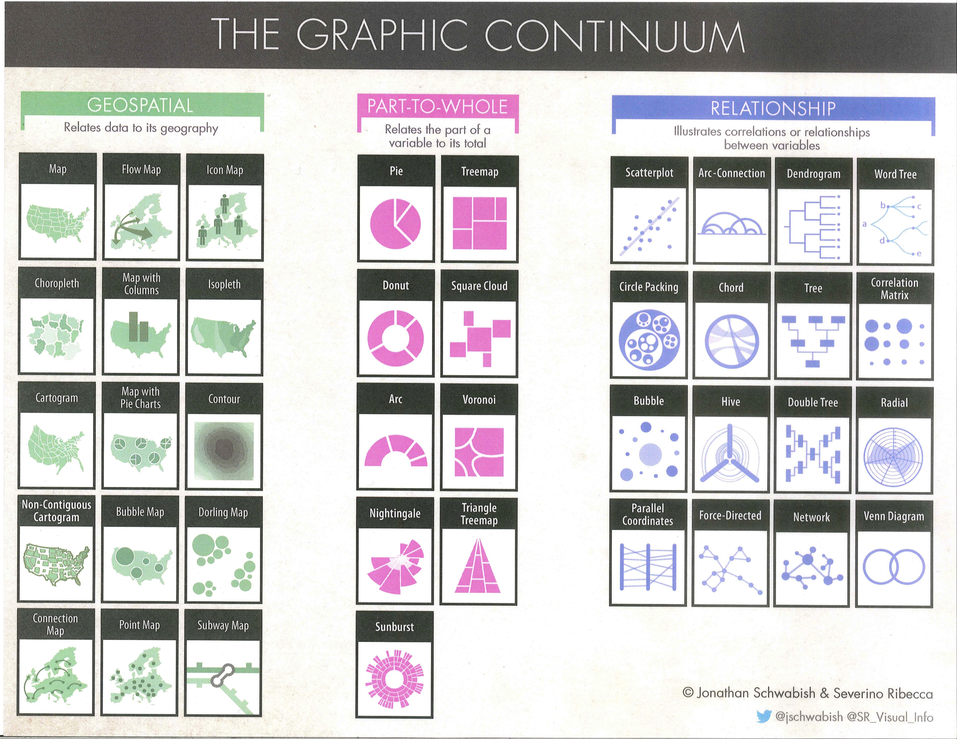

Slide 20
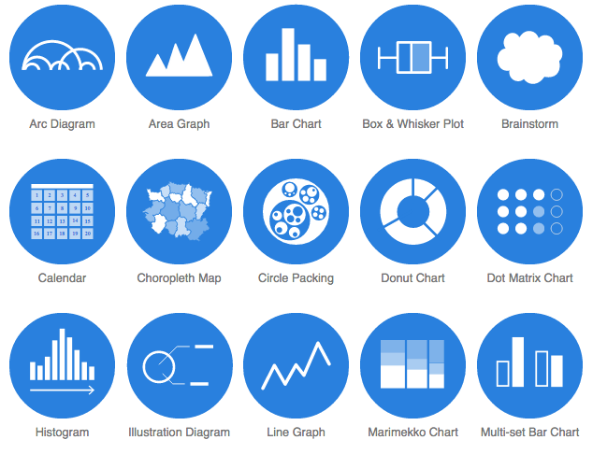
Charting: Data Viz Catalogue
Notes:
http://www.datavizcatalogue.com/

Slide 21
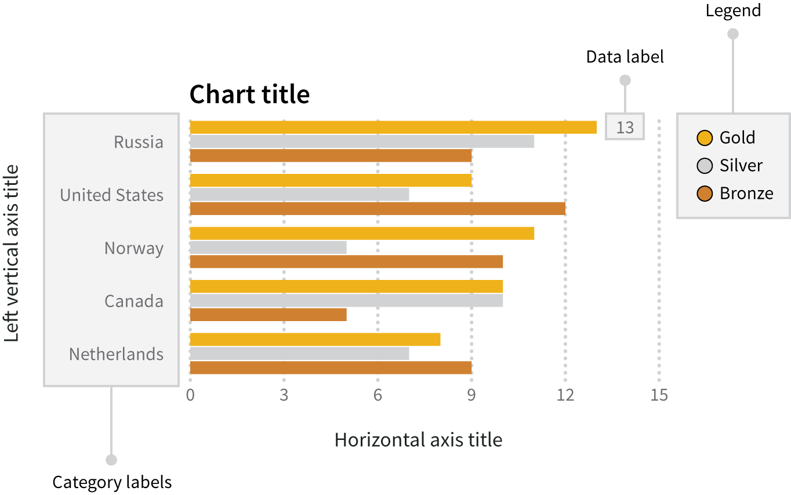
Anatomy of a Chart
Source: Data + Design. Chapter 14: Anatomy of a Graphic.
Notes:
Note: labels, guidelines, title, key, including function of each. Title is like a headline. When labeleing be sure to include units. Point out that this chart is missing a SOURCE indicator, which is essential.

Slide 22
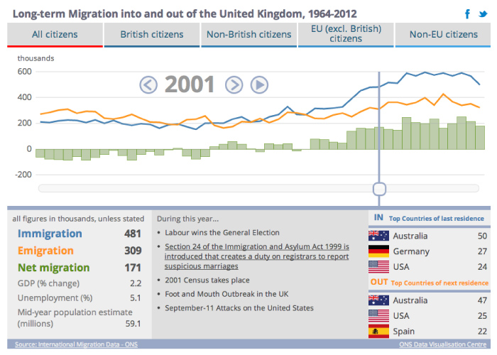
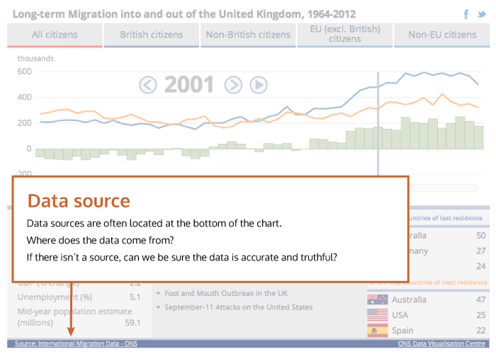
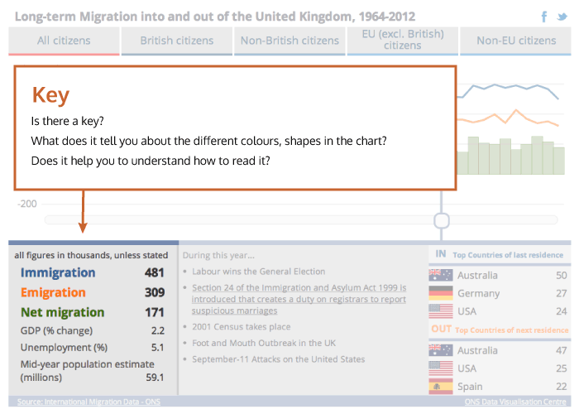
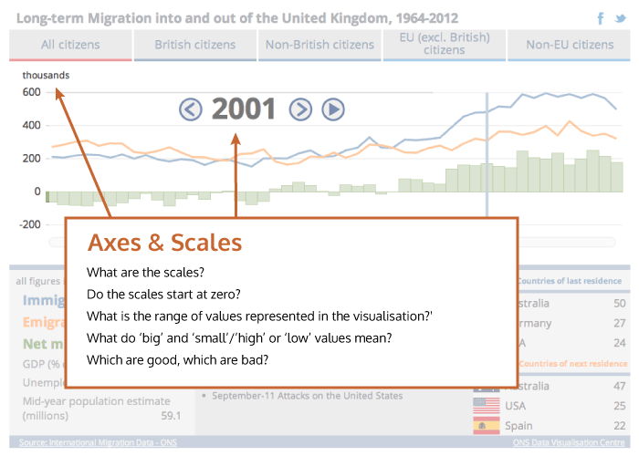
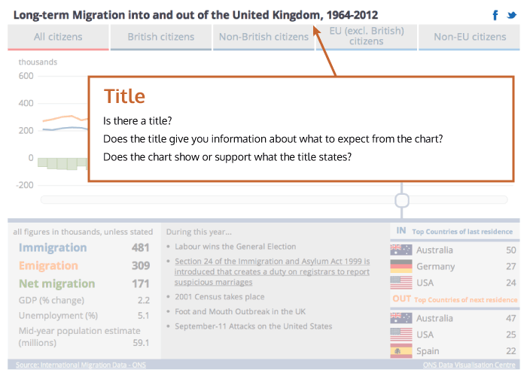
http://seeingdata.org/understanding-data-visualisations/top-5-things-to-look-for-in-a-visualisation/
Notes:
Source, also methods; title and guff or chatter.

Slide 23
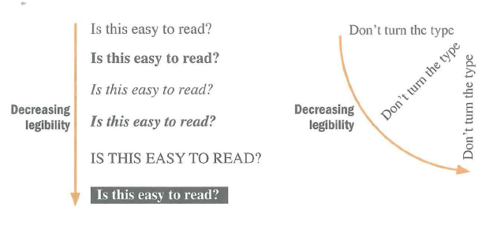
Chart Legibility

Slide 24
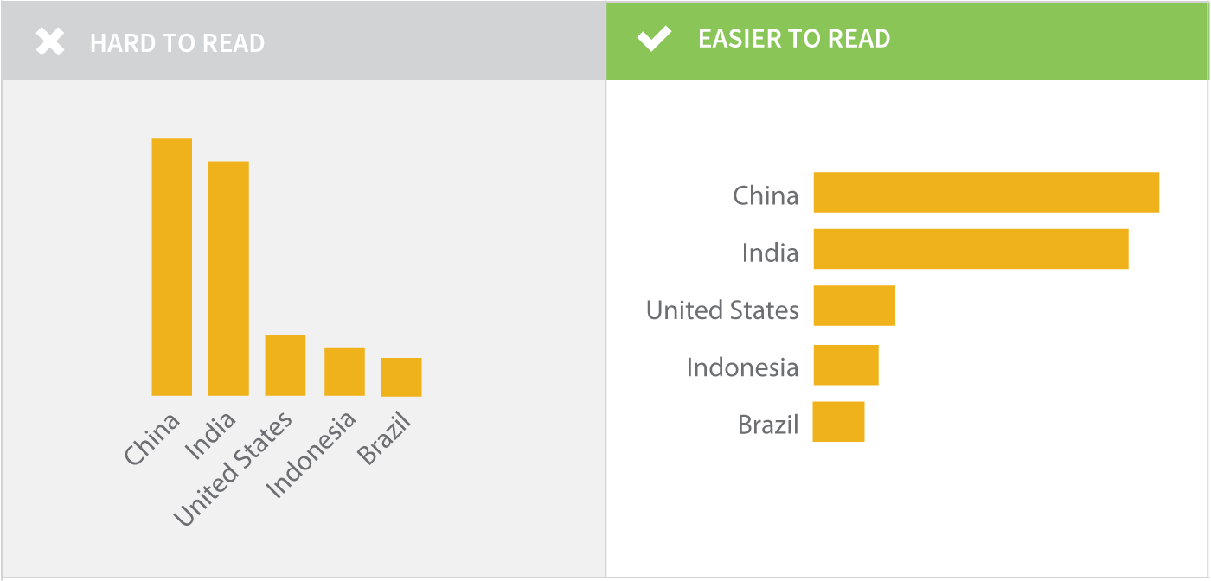
Chart Legibility
Source: Data + Design. Chapter 14: Anatomy of a Graphic.

Slide 25
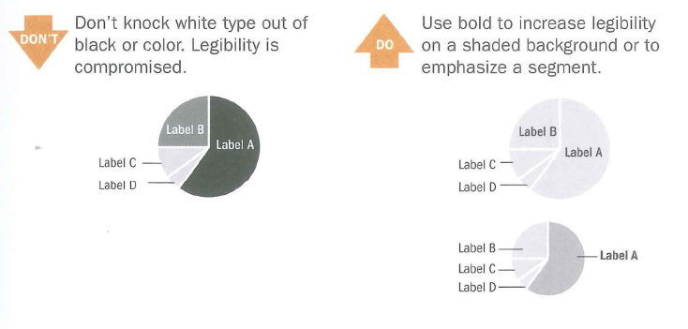
Chart Legibility

Slide 26
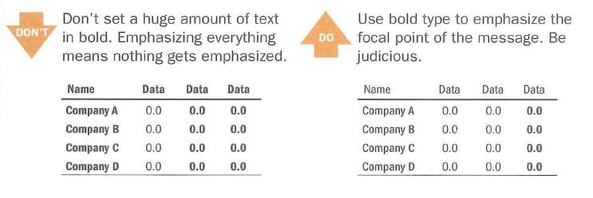
Chart Legibility

Slide 27
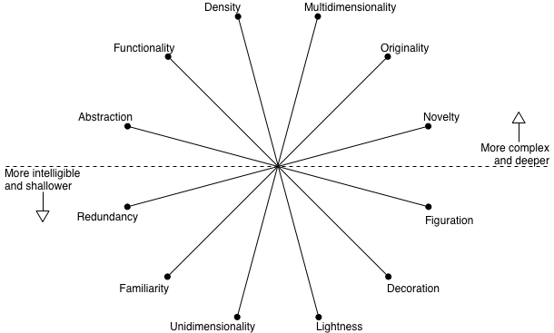
The Visualization Wheel
Notes:
Besides just efficiently encoding information, and legible presentation, there are other design dimensions we might consider and strive to balance in an information graphic. The Vis wheel can be useful for thinking through your designs.
Complexity = effort readers have to invest in deciphering a graphic
Need to always ask: what is the visualization going to be used for, and who is the audience?
Some of these dimensions if emphasized might be better for arousing curiosity, or they may be more memorable, or more utilitarian. Some may be better for more or less experienced readers.

Slide 28
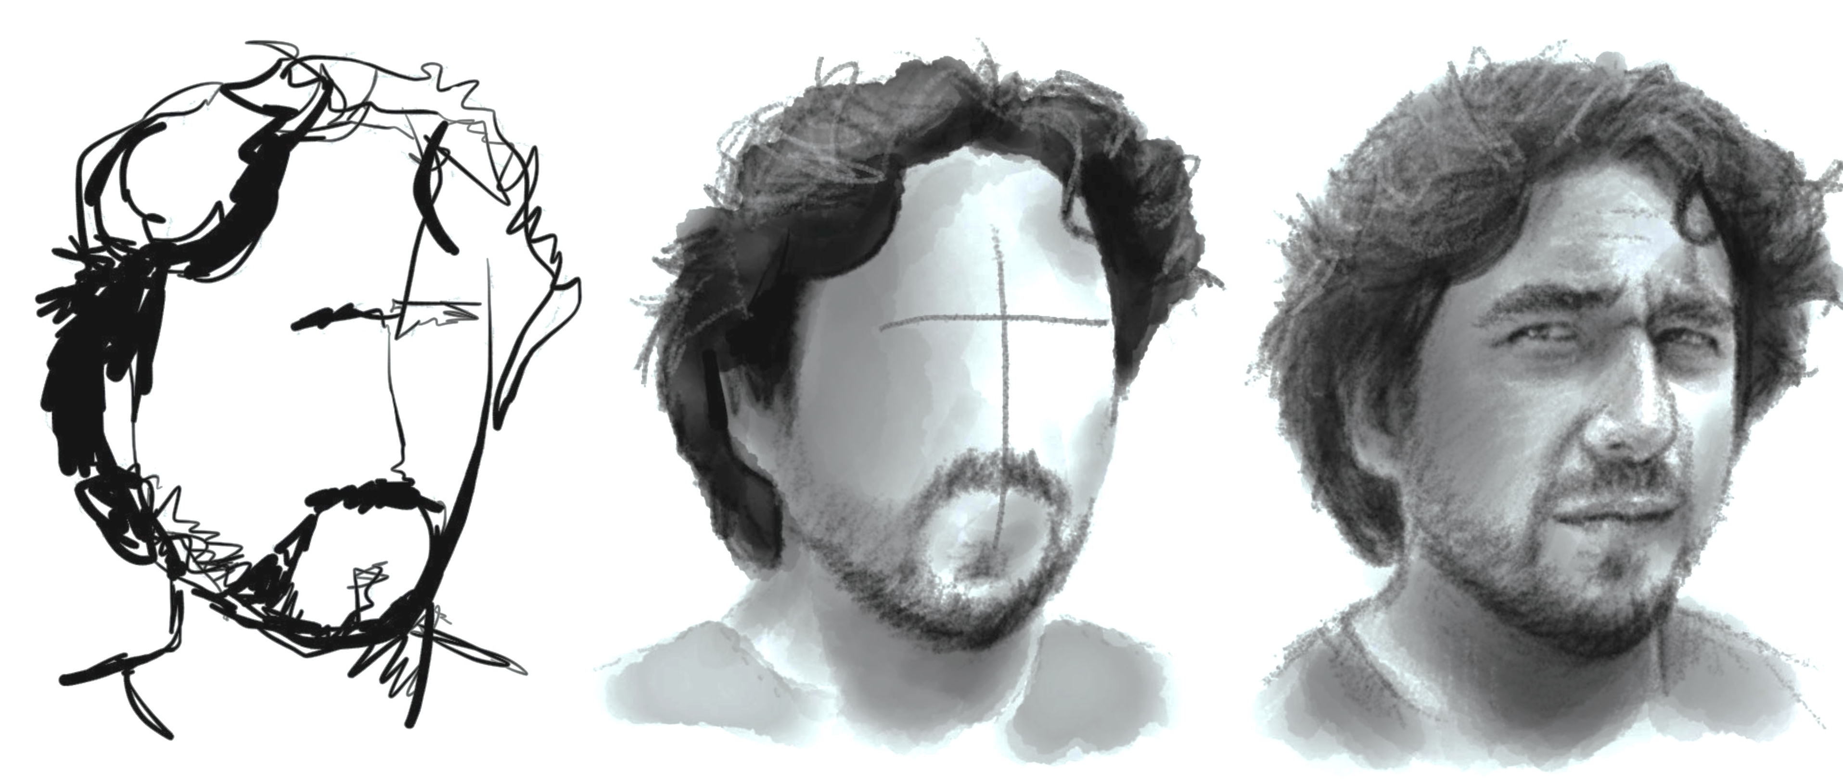
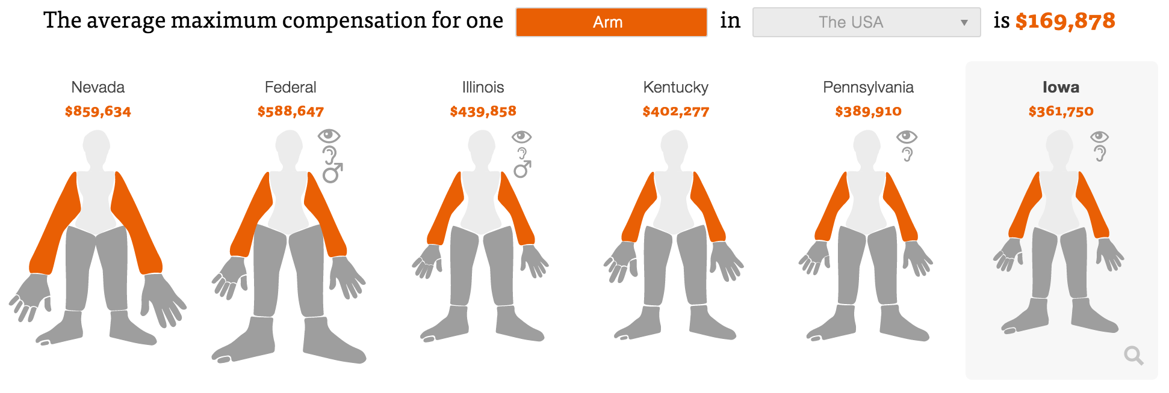
Abstraction – Figuration
Figurative
Representation mimics real world
Abstract
Conceptual, reduced realism, doesn’t map directly to world
https://projects.propublica.org/graphics/workers-compensation-benefits-by-limb#

Slide 29
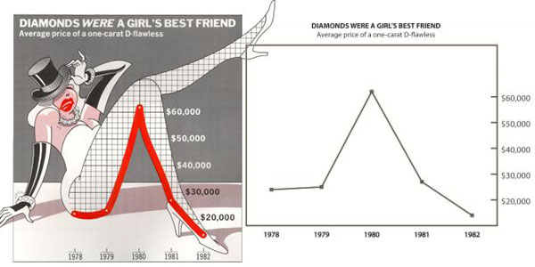
Functionality – Decoration
Decoration
Non-functional elements that do not aid interpretation
“Chartjunk” – “If the numbers are boring, then you’ve got the wrong numbers” – E. Tufte.

Slide 30
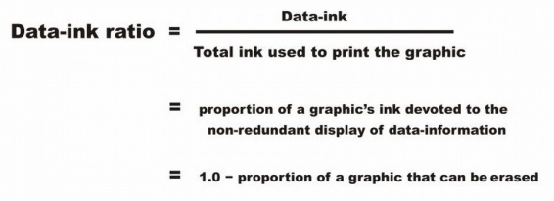
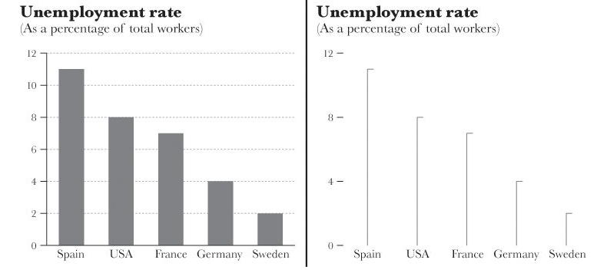
Density – Lightness (Data-Ink Ratio)

Slide 31
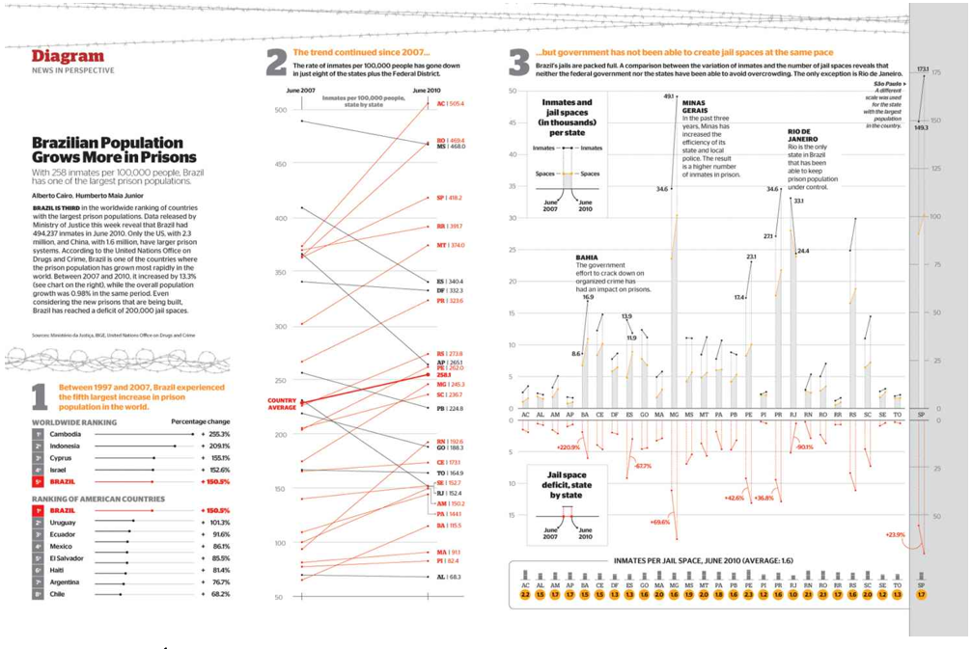
Multidimensionality – Unidimensionality
Notes:
Number of forms used to encode data. Layers of data available for use to navigate.

Slide 32
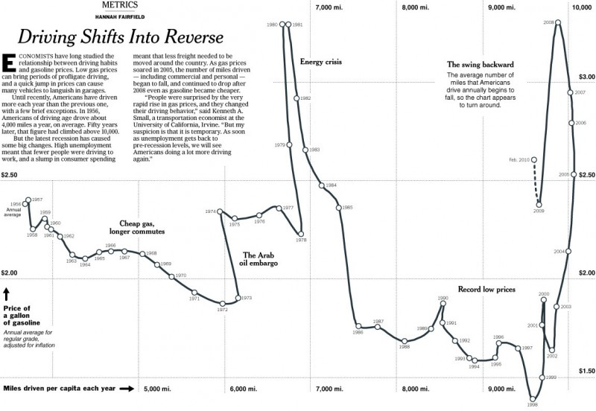
Originality – Familiarity

Slide 33
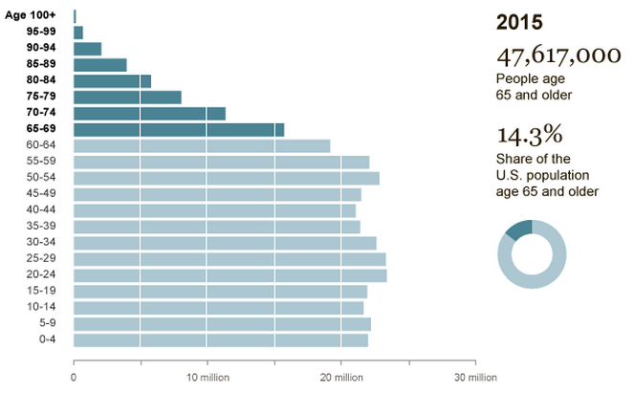
Novelty – Redundancy
Notes:
Novelty: explain many different things once
Redundancy: explain same things several times
Example: on right there is redundancy, on left there is a novel view showing more detail on the distribution

Slide 34
User-Centered Design
What is this visualization for?
Explaining, exploring, contextualizing
Who is the audience?
How much knowledge of the topic do they have?
Try to clarify, not simplify
Do I want to …
…arouse curiosity
…make this memorable
…have people spend more time
…facilitate a decision efficiently
Notes:
Need to always ask: what is the visualization going to be used for, and who is the audience?
Some of these dimensions if emphasized might be better for arousing curiosity, or they may be more memorable, or more utilitarian. Some may be better for more or less experienced readers.
For instance some studies of so-called chartjunk show that those graphs are more memorable, and that the high data-ink ratio version of charts are not preferred by users.

Slide 35
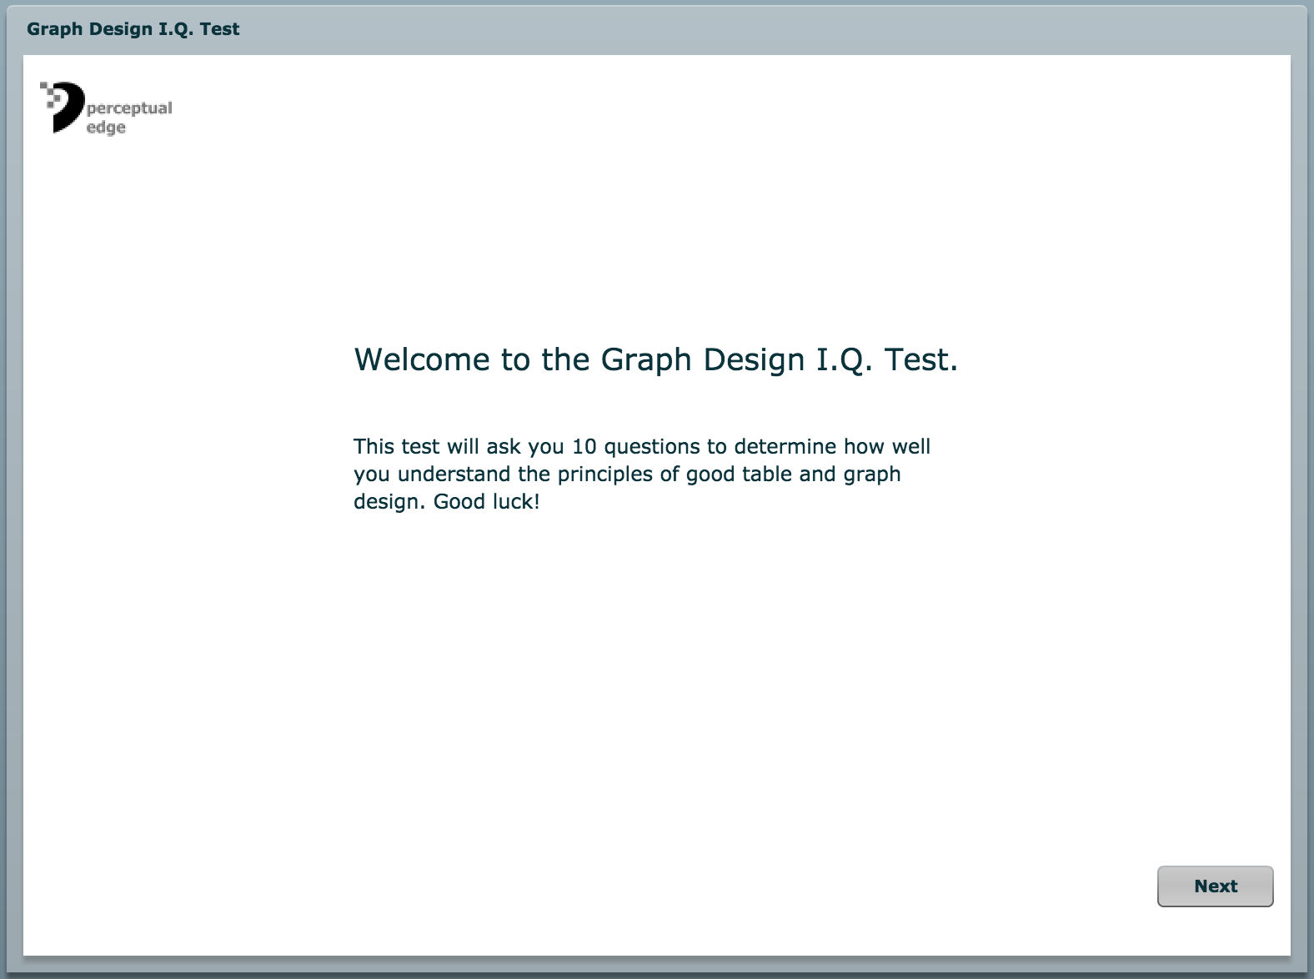
Notes:
A group quiz for discussion.

Slide 36
Questions?

